Slide 1
Hack To The Future

Slide 2
Team Members

Slide 3

Hack To The Future - Members
Azola Lukhozi
Nozibusiso Myeni
Abdul Dramat
Cebolenkosi Gumpo
Banele Ngcethane

Slide 4


Agenda
# | Section | Description
1 | Overview
2 | Approach
3 | Justification
4 | Implementation
5 | Benefits | A
6 | Innovation | A
7 | Demo
8 | Questions

Slide 5
Overview
Hack To The Future

Slide 6
Hack To The Future - Overview
Advanced Fraud Detection for Financial Services
Old Mutual needs an advanced real-time fraud detection system to safeguard against increasingly sophisticated fraudulent activities. The challenge is to develop a solution that leverages machine learning, behavioral analysis, and real-time monitoring to detect and respond to fraud. The system should integrate with existing financial systems, provide effective alert and response mechanisms, and ensure data privacy and compliance. It involves creating algorithms for fraud detection, developing an alert system, and preparing comprehensive documentation.

Slide 7
Approach
Hack To The Future

Slide 8
Approach - Services
Presentation
Logic
Transport
Data
Quicksight
SES
Lambda
SageMaker
GatewayAPI
Kinesis Data Firehose
S3 Bucket
SageMaker

Slide 9
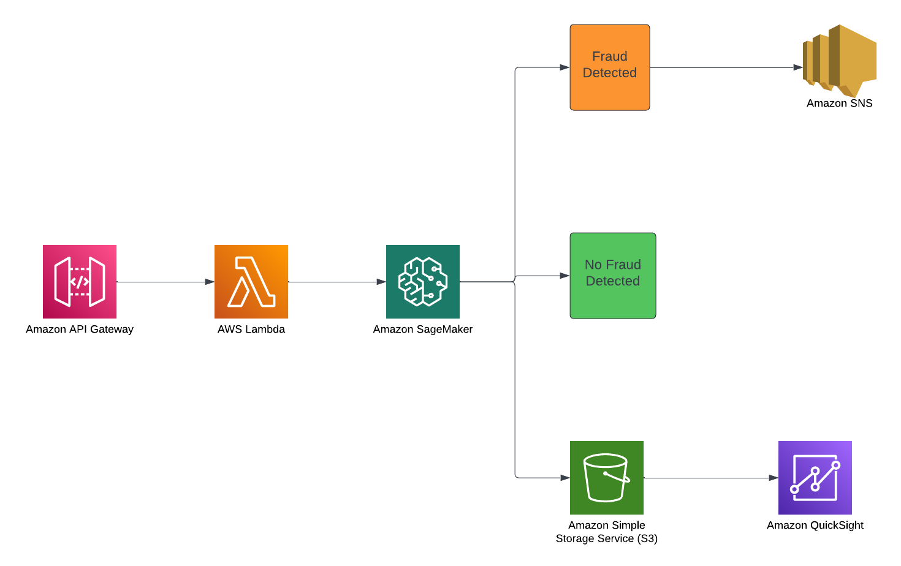
Approach - Architectural Design

Slide 10
Implementation
Hack To The Future

Slide 11
Benefits
Hack To The Future

Slide 12
Innovation
Hack To The Future

Slide 13
Demo
Hack To The Future

Slide 14
Questions

Slide 15
Thank You!

